Slide 1
IBM University Engagement Project Submission
“Exploring the Power of Agentic AI with IBM Granite and IBM Bob”

Slide 2

Project Tile – [AI Nutrition Coach]
Domain of Project – [ Healthcare]
Faculty Name | Recent Passport Photo | Email ID | Mobile number [WhatsApp]
Narayan Jee |  | narayan.btech@gmail.com | 9031208697

Slide 3
Problem Statement :
Problem Statement: AI-Powered Nutrition Agent
Challenge:
Individuals struggle with diet planning, portion control, and nutrient tracking.
Reliable nutrition and disease-specific dietary information is scattered across multiple sources.
Lack of personalized, real-time guidance leads to unhealthy food choices and poor diet management.
Objective: Develop an AI-powered Nutrition Agent that provides personalized dietary recommendations and nutrition management for individuals, families, and healthcare professionals.
Key Features:
Personalized Diet Plans: Based on age, health conditions, allergies, cultural preferences, and fitness goals.
Nutrition Knowledge (RAG): Retrieve and summarize reliable nutritional information (calories, macros, vitamins, minerals).
Smart Food Logging: Record meals via text, image, or voice with instant nutritional analysis.
Preventive Health Support: Recommend diets for chronic disease management (e.g., diabetes, heart health).
Multi-Agent Architecture:
Nutrition Knowledge Agent
Diet Recommendation Agent
Health Advisory Agent
Food Log & Feedback Agent
Analytics Dashboard: Visualize daily/weekly nutrient intake, deficiencies, calorie trends, and health progress.
Outcome: An intelligent, AI-driven nutrition assistant that enables informed food choices, promotes healthier lifestyles, and supports preventive healthcare through personalized, evidence-based recommendations.

Slide 4
Proposed Solution:
Proposed Solution: AI-Powered Nutrition Agent
Multi-Agent AI System built using IBM Bob, IBM watsonx.ai, and Granite Models for personalized, real-time nutrition guidance.
RAG-Based Nutrition Engine retrieves trusted food and nutrition data (e.g., USDA, WHO) using vector embeddings for accurate recommendations.
Four Intelligent AI Agents:
Nutrition Knowledge Agent: Retrieves & summarizes nutritional information.
Diet Recommendation Agent: Creates personalized meal plans based on user profile and health goals.
Health Advisory Agent: Provides preventive and disease-specific dietary guidance.
Food Log & Feedback Agent: Analyzes meals logged via text, voice, or images and offers instant feedback.
Interactive Dashboard: Displays calorie intake, nutrients, deficiencies, dietary trends, and progress toward health goals.
Technology Stack:
IBM Bob: Multi-agent orchestration
IBM watsonx.ai: Model deployment, embeddings, and AI governance
Granite Models: Reasoning, summarization, and personalization
Outcome: An end-to-end intelligent nutrition assistant that enables informed food choices, personalized diet planning, and preventive healthcare through AI-driven insights.

Slide 5
Technology Used
IBM Bob platform -For designing and orchestrating multi-agent workflows visually
IBM Grainte model - for eg – ibm-granite-3-2-8b – For natural language understanding, reasoning, and personalization
IBM Cloud – It provides the infrastructure to build, deploy, and scale the Nutrition Agent efficiently. IBM Cloud enables a reliable, secure, and scalable environment for deploying the Nutrition Agent.
RAG– RAG to fetch real data first, then generate intelligent answers, making the Nutrition Agent more trustworthy and effective.
IBM Watsonx.ai - For model deployment, embeddings, and AI governance
Vector Database (FAISS/Chroma) – For RAG-based nutritional data retrieval

Slide 6
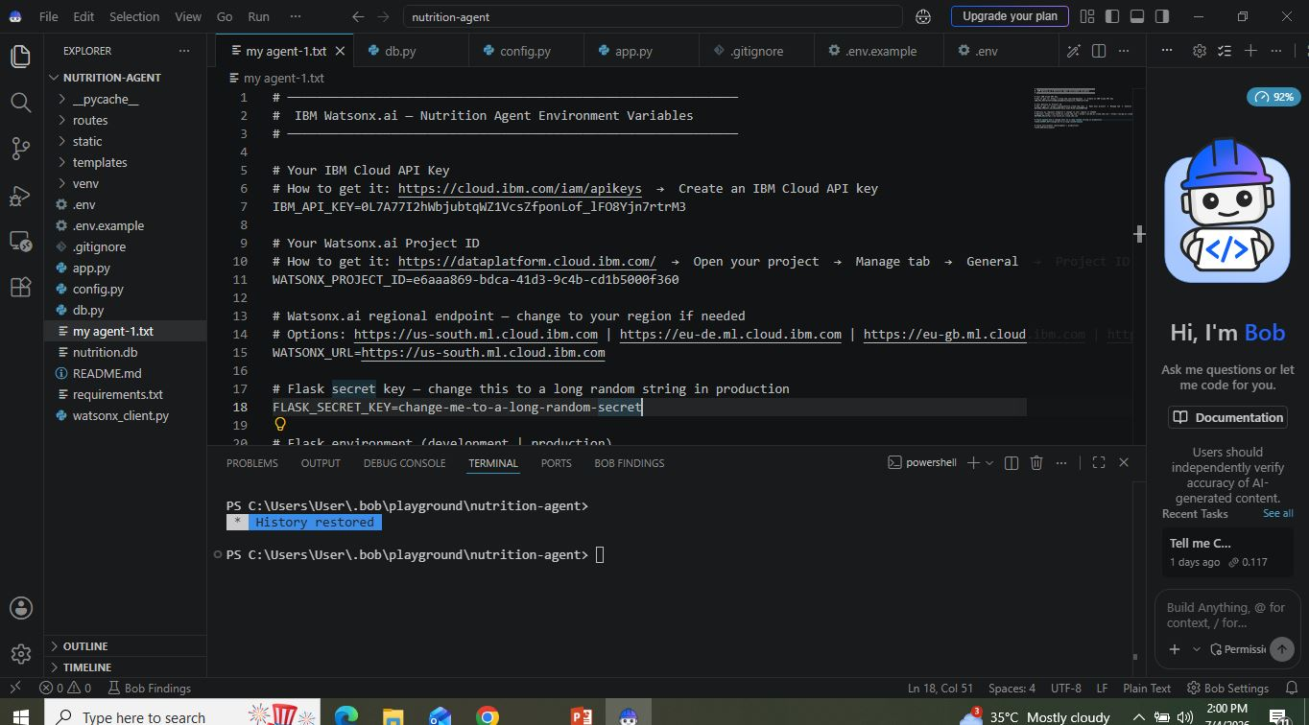
Required Files created using IBM bob -
App.py
Requirements.txt
Style.css
.env
Index.html

Slide 7
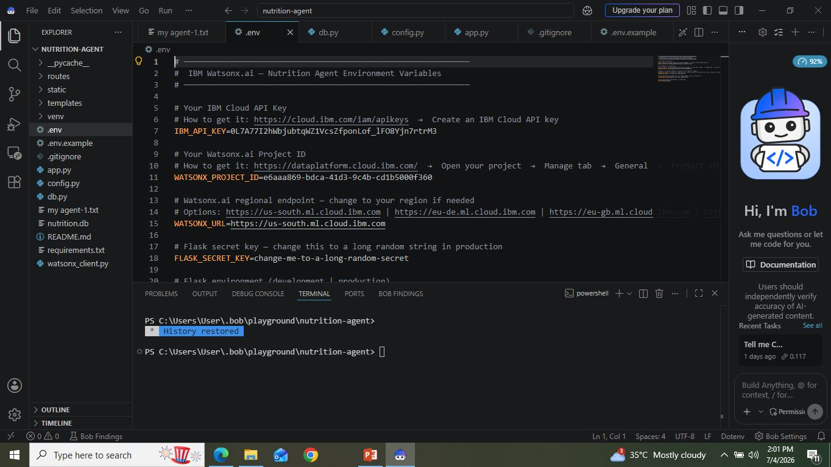
IBM Bob Screenshots:

Slide 8
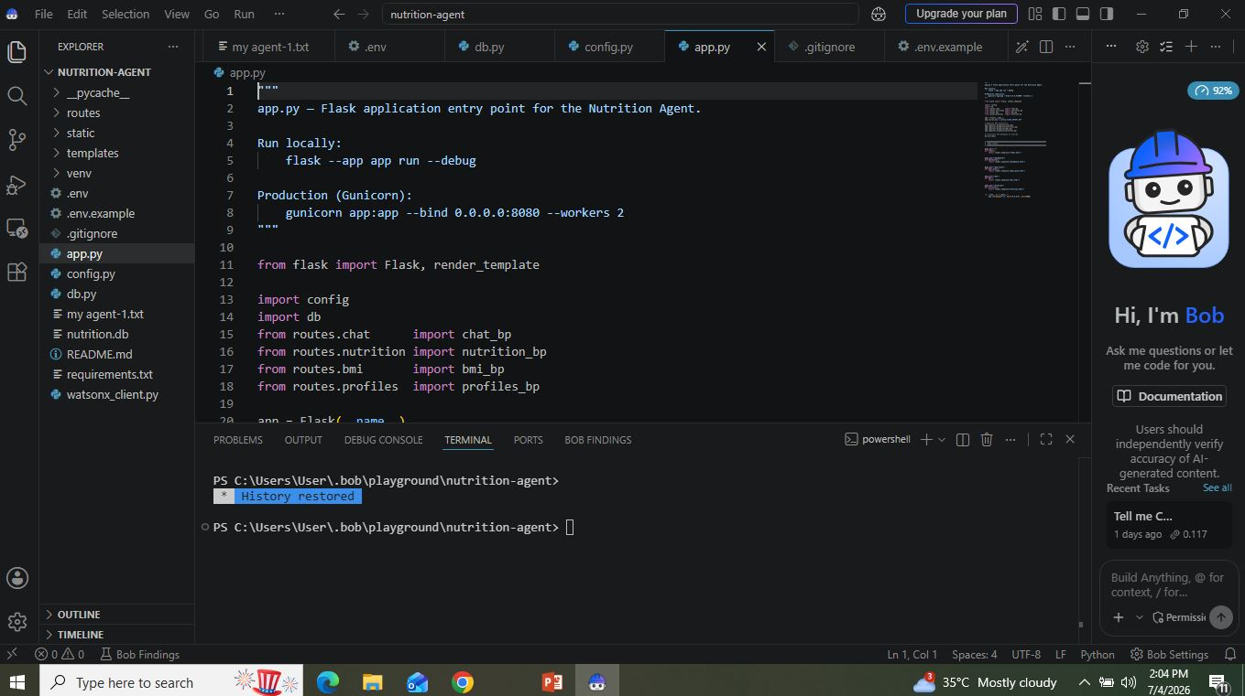

Slide 9
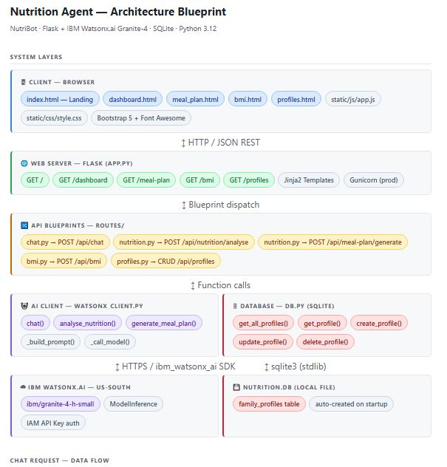
Architecture blueprint for IBM bob:

Slide 10

Role of Agentic AI in the solution
Role of Agentic AI in Nutrition Agent
Autonomous Multi-Agent Intelligence: Agentic AI transforms the Nutrition Agent from a chatbot into an intelligent, goal-driven assistant using IBM watsonx.ai and Granite Models.
Specialized AI Agents: Each agent performs a dedicated task:
Nutrition Knowledge Agent: Retrieves trusted nutrition data.
Diet Recommendation Agent: Generates personalized meal plans.
Health Advisory Agent: Provides preventive and disease-specific dietary guidance.
Food Log & Feedback Agent: Analyzes meals and delivers instant feedback.
Context-Aware Personalization: Understands user profiles (age, health conditions, allergies, lifestyle, and fitness goals) to provide customized recommendations.
Real-Time Adaptation: Continuously updates dietary advice based on meal logs, user preferences, and health progress.
Collaborative Decision-Making: Agents communicate and coordinate to deliver accurate, consistent, and comprehensive nutritional insights.
Outcome: Agentic AI enables a proactive, personalized, and intelligent digital nutritionist that empowers users to make healthier food choices and achieve long-term wellness goals.

Slide 11
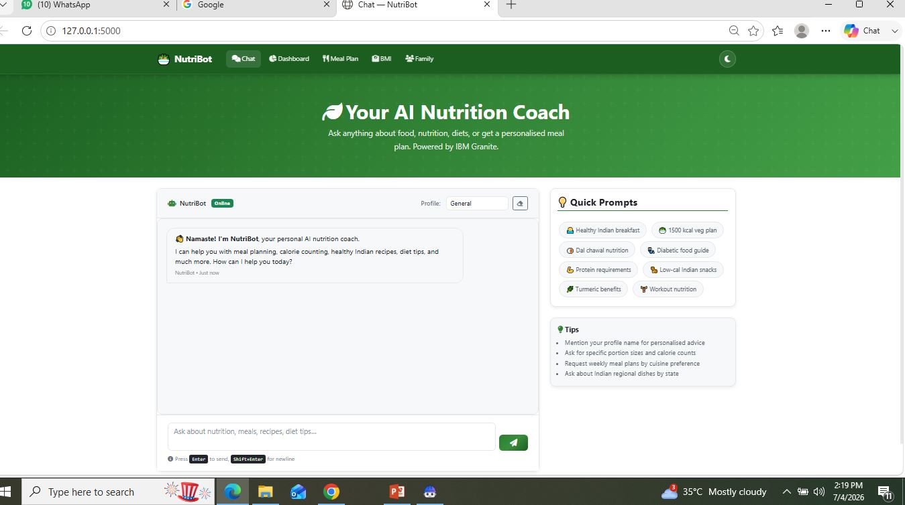
Project Output Screenshot
Please put IBM Bob output screenshots with 2-3 prompts.
You can take 2-3 more slides for each screenshot
·
·
·

Slide 12
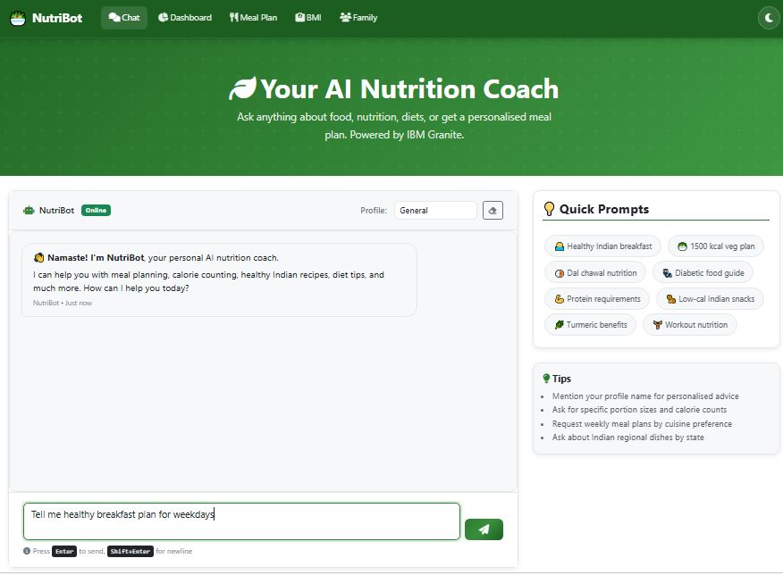
Project Output Screenshot
Please put IBM Bob output screenshots with 2-3 prompts.
You can take 2-3 more slides for each screenshot
·
·
·

Slide 13
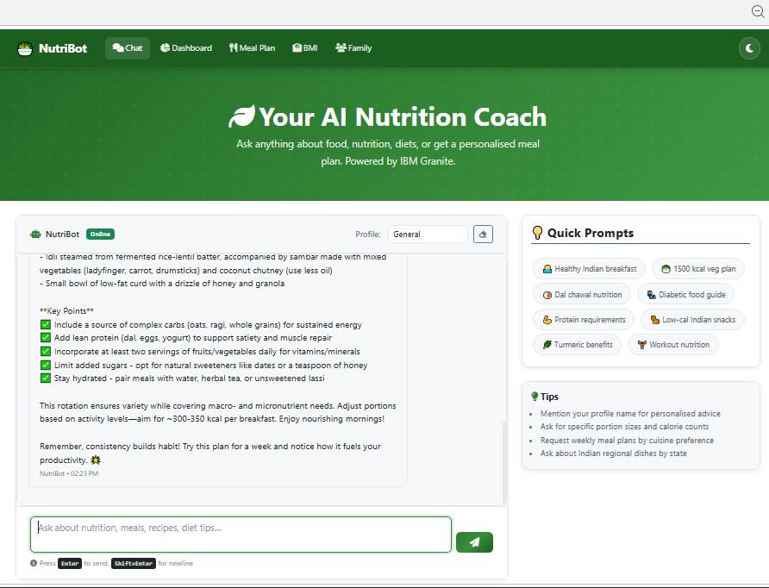
Project Output Screenshot
Please put IBM Bob output screenshots with 2-3 prompts.
You can take 2-3 more slides for each screenshot
·
·
·

Slide 14
Novelty and Uniqueness
Novelty & Uniqueness of the AI-Powered Nutrition Agent
Multi-Agent AI Architecture: Employs specialized AI agents that collaborate autonomously for nutrition analysis, diet planning, health advisory, and meal tracking.
RAG-Enabled Knowledge Retrieval: Combines Retrieval-Augmented Generation (RAG) with trusted nutrition databases (e.g., USDA, WHO) to provide accurate, evidence-based recommendations.
Highly Personalized Nutrition: Generates diet plans tailored to age, medical conditions, allergies, cultural preferences, and fitness goals.
Multimodal Food Logging: Supports meal tracking through text, voice, and image inputs with instant nutritional analysis.
Preventive Healthcare Focus: Goes beyond calorie counting by recommending disease-specific diets for conditions such as diabetes and cardiovascular diseases.
Explainable & Responsible AI: Built on IBM watsonx.ai and Granite Models to ensure transparent, reliable, and scalable AI decision-making.
Real-Time Insights Dashboard: Provides interactive visualization of nutrient intake, deficiencies, dietary trends, and health progress.
Key Innovation: An end-to-end Agentic AI-powered nutrition ecosystem that seamlessly integrates intelligent reasoning, trusted knowledge retrieval, personalized recommendations, and real-time health monitoring in a single platform.

Slide 15
Git Hub Link
Github URL –
jeeNarayan/AI-Nutrition-Agent
·
·
·

Slide 16
Future Scope
Integration with Wearable Devices: Connect with smartwatches and fitness trackers for real-time monitoring of activity, calories burned, heart rate, and sleep patterns.
AI-Based Health Prediction: Use predictive analytics to identify nutritional deficiencies and assess the risk of lifestyle diseases before symptoms appear.
IoT & Smart Kitchen Integration: Recommend meals based on available ingredients, smart refrigerators, and pantry inventory.
Continuous Learning & Personalization: Adapt recommendations over time based on user habits, health progress, and feedback.
Community & Family Nutrition: Support family meal planning, group health tracking, and wellness challenges.
Vision: Develop a comprehensive AI-driven digital nutrition ecosystem that delivers personalized, preventive, and accessible healthcare for individuals and communities.
·
·
·

Slide 17
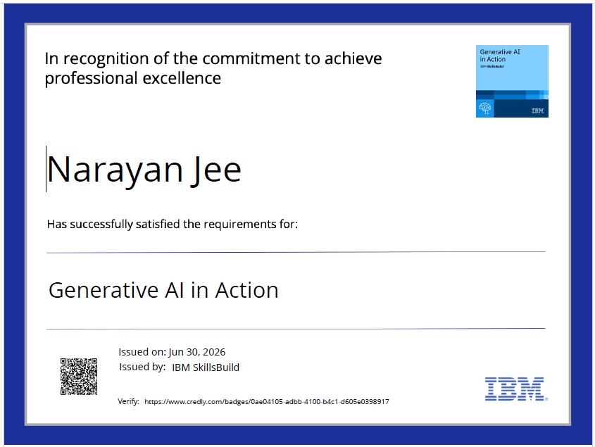
Certificates Earned:

Slide 18
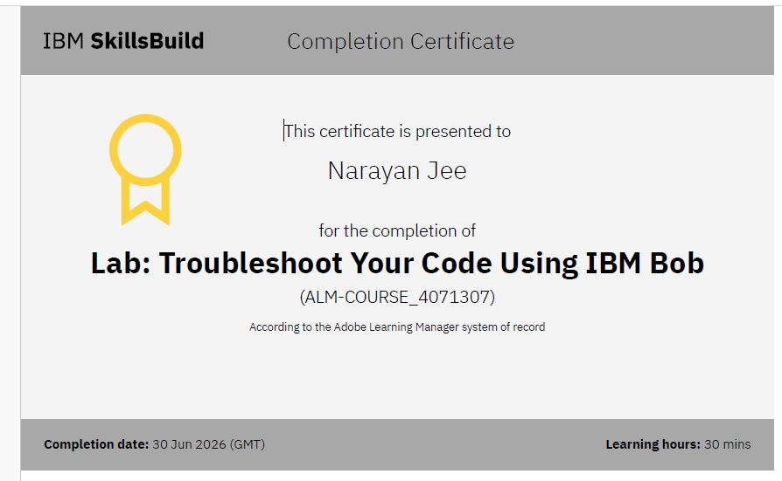
Certificates Earned:

Slide 19
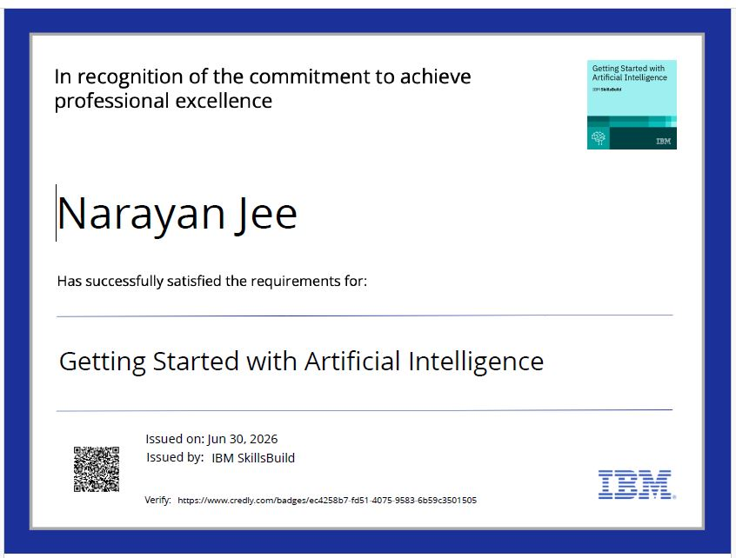
Certificates Earned:

Slide 20
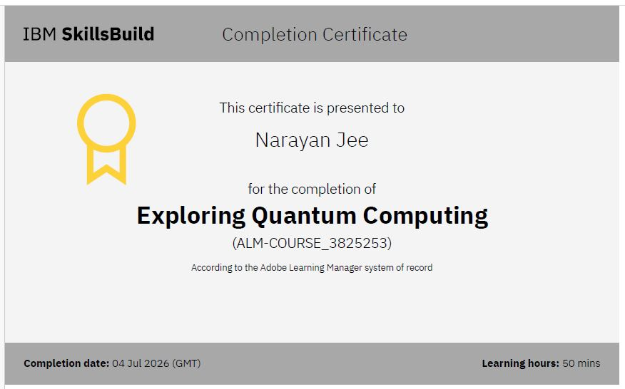
Certificates Earned:

Slide 21
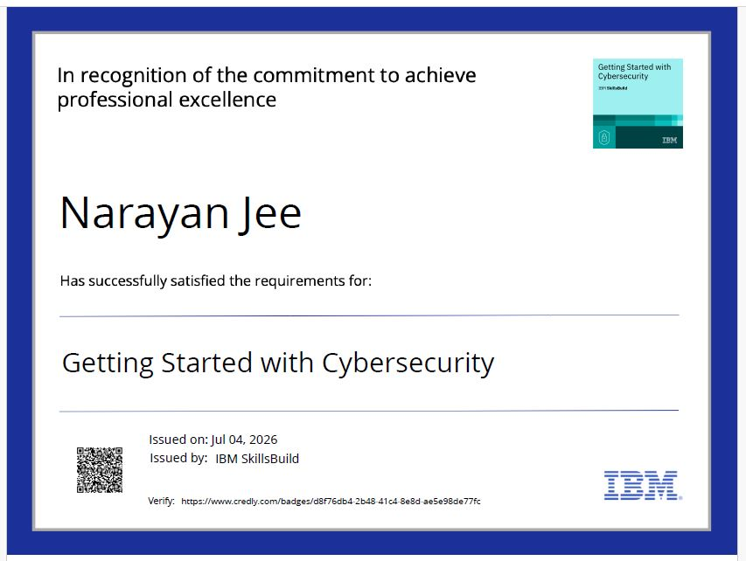
Certificates Earned:

Slide 22


